Slide 1
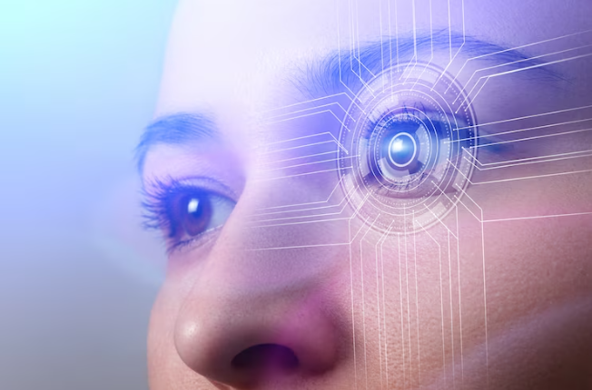

Computer Vision
Pose Detection System

Slide 2
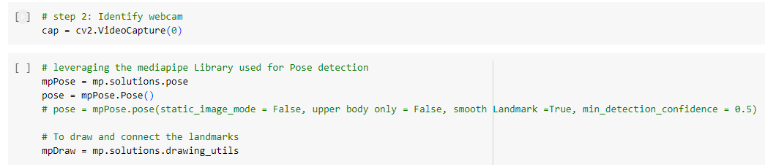
Using CV2 and mediapipe library:
Created a system capable of identifying human pose using Computer Vision.

Slide 3
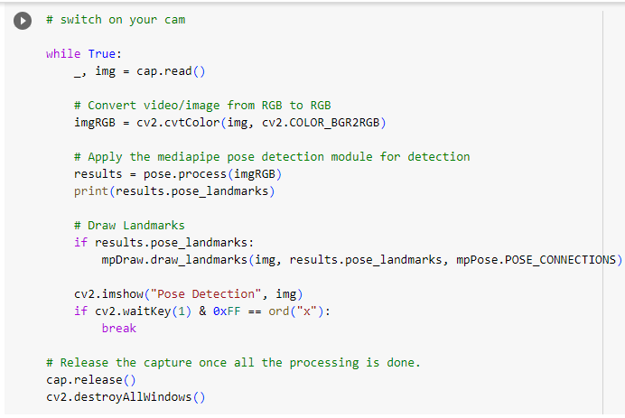
Using CV2 and mediapipe library:

Slide 4
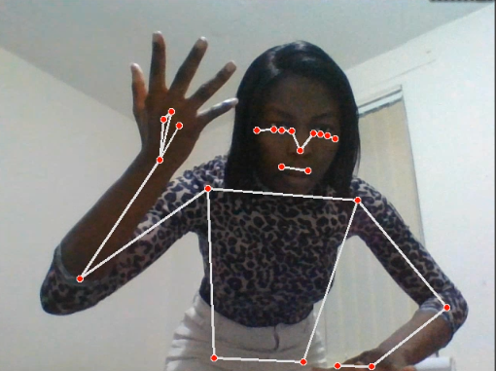
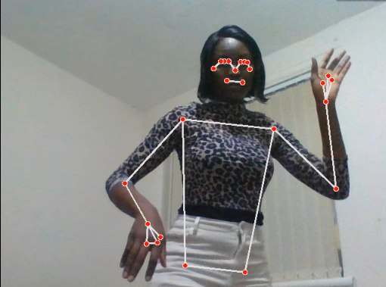
Detected Pose from the camera

Slide 5
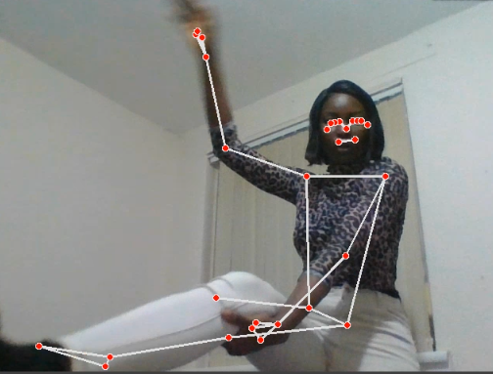
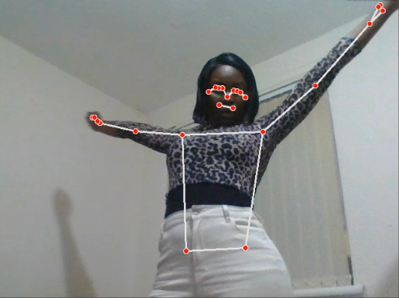
Detected Pose from the camera

Slide 6
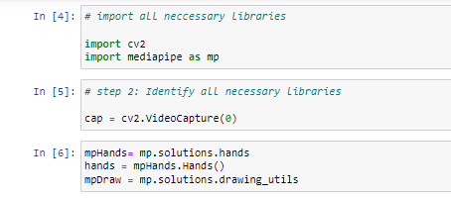
Leveraged haar cascade for hand detention

Slide 7
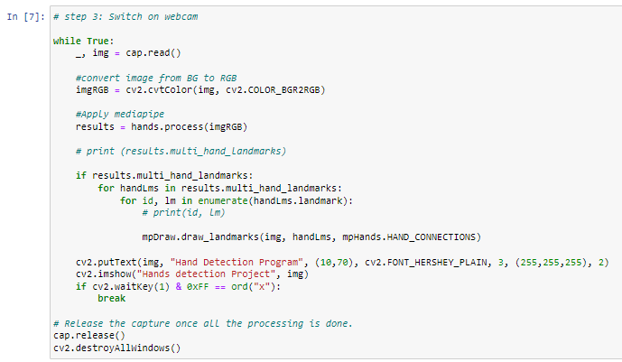
Leveraged haar cascade for hand detention

Slide 8
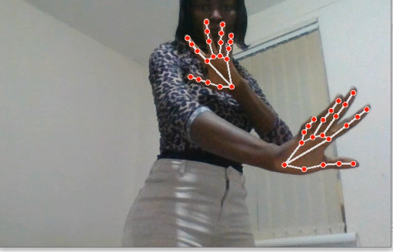
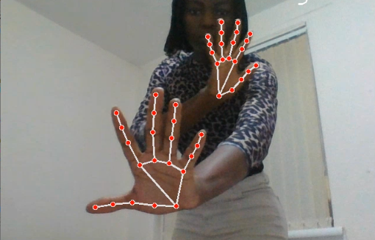
Detected hand from the camera

Slide 9
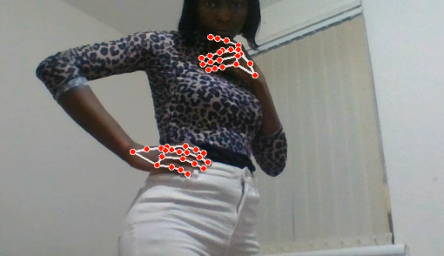
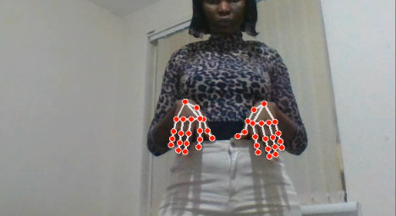
Detected hand from the camera

Slide 10
conclusion
Accomplished the development of a versatile system capable of detecting human body poses and hand gestures. This achievement marks a substantial leap forward in the realm of computer vision and has broad applications across multiple domains. From improving user interactions in virtual reality environments to enhancing gesture-based control systems, this system's potential is far-reaching.
Moreover, it has the potential to revolutionize fields like healthcare, enabling precise monitoring of patient movements and aiding in physical therapy. With the ability to understand and respond to both body poses and hand gestures, this system unlocks countless possibilities for innovation and promises to redefine the way we interact with technology and the world around us.

